Slide 1

Pranamya Akella - 1266719
Saranya Govvala - 1269850

Slide 2
Agenda
Introduction to AWS S3……………………………………………………….. Saranya
Introduction to AWS EC2……………………………………………………… Saranya
IAM roles…………………………………………………………………………….. Saranya
Problem statement……………………………………………………………… Saranya
Project Deliverables…………………………………………………………….. Pranamya
Methodology………………………………………………………………………. Pranamya
Demo for exploiting S3…………………………………………………………. Pranamya
Demo for Getting sensitive information………………………………. Pranamya
Case study for Exploiting EC2………………………………………………. Saranya
Mitigations………………………………………………………………………….. Pranamya

Slide 3
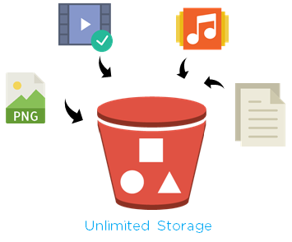




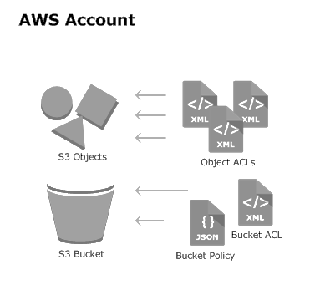
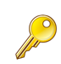
How S3 works?
Introduction to AWS Simple Storage Service (S3)
Storage for internet
Store any amount and retrieve from anywhere
Provides
Scalability
Availability
Security
Performance
Customers of all sizes can use
Bucket policies
Encryption
Client
Bucket with objects
Presenter: Saranya
Server

Slide 4





Introduction to AWS Elastic Compute Cloud (EC2)
Instances
Various instances like windows linux , ubuntu and others
Internet
MY
AMIs
AWS Management Console
AWS Marketplace
AMIs-Amazon Machine Images
Community AMIs
EC2
User
AWS Cloud
Presenter: Saranya

Slide 5




Identity and Access Management (IAM)
Bucket Policy
User Policy {Attach IAM Role}
Ec2- S3 Full Access
Access
Sensitive information
Bucket
User
Presenter: Saranya

Slide 6
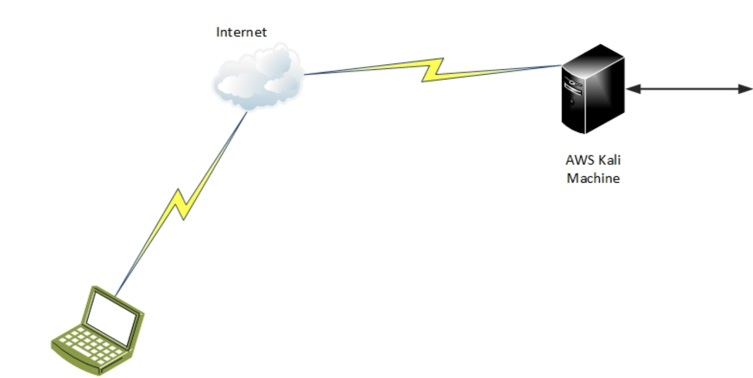

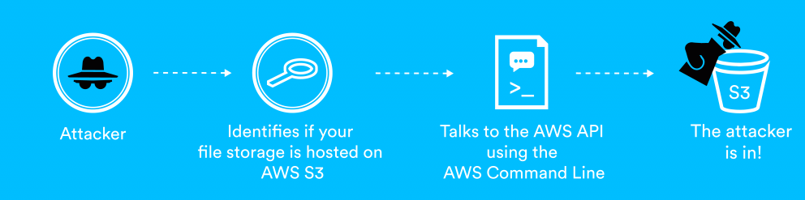
Problem Statement
Misconfigurations in S3
AWS S3 Full Access to EC2
Vulnerable applications on EC2 instances
Wrongly configured Inbound and outbound rules
Public S3 Bucket
Vulnerable EC2 instances
Presenter: Saranya

Slide 7
Project deliverables
Creating and exploiting vulnerable S3 buckets
Launching XSS attack
Capturing sensitive data - metadata
Exploiting EC2 instances
Installing vulnerable Jenkins server on Windows EC2 instance
Using metasploit to exploit vulnerable jenkins modules
Presenter: Pranamya

Slide 8

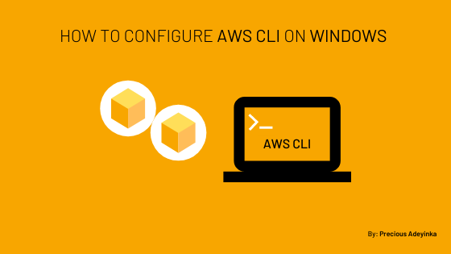




Tools
Kali linux
AWS CLI
AWS Bucket Dump
curl
Jenkins
Metasploit
Presenter: Pranamya

Slide 9
Methodology - S3
Phase 1
Phase 2
Phase 3
Information gathering
Research s3 vulnerabilities
Learn misconfigurations
In vulnerable buckets
Modeling/planning
creating vulnerable buckets
setting up attack environment
Vulnerability analysis
scanning vulnerable buckets using AWSBucketDump
uploading malicious js file
Phase 4
Phase 5
Phase 6
Exploitation
XSS attack
Extracting metadata
Post-exploitation
s3 security analysis
mitigation
Reporting
Interesting findings
Analysis
Presenter: Pranamya

Slide 10
Methodology - EC2
Phase 1
Phase 2
Phase 3
Information gathering
Research EC2 vulnerabilities
Learn exploiting EC2 instances, Jenkins application
Modeling/planning
creating vulnerable EC2 instances
setting up attack environment using vulnerable Jenkins server
Vulnerability analysis
Search for vulnerable jenkins modules using metasploit
Phase 4
Phase 5
Phase 6
Exploitation
Metasploit to exploit jenkins module
Post-exploitation
EC2 security analysis
Security defenses
Reporting
Interesting findings
Analysis
Presenter: Pranamya

Slide 11



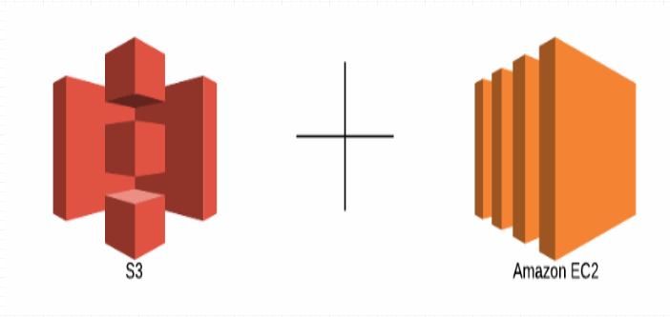
S3 Bucket exploitation
Kali linux machine
AWS Bucket dump
Upload malicious files
User
Bucket
Capture metadata
Connecting to EC2
Presenter: Pranamya

Slide 12
S3 Exploitation Demo
Presenter: Pranamya

Slide 13










A case study on EC2 Instance Exploitation
Vulnerable Jenkins
3
2
Windows Instance
Set Ip and Port
1
Search for jenkins
User
EC2
4
Load Metasploit
6
7
5
Kali Linux Instance
Presenter: Saranya

Slide 14
EC2 Case study Demo
Presenter: Saranya

Slide 15
Security defenses - S3
Use server side and client side encryption methods
Limiting IAM permissions
Restricting access using bucket policies
Increasing reliability with replication
Enabling object locks
Presenter: Pranamya

Slide 16
Security defenses - EC2
Updates and security patches of underlying OS
Implement security group firewall configurations
Avoid placing critical instances in public subnets
Using custom policies
Enabling Access Control Lists
Presenter: Pranamya

Slide 17
References
https://medium.com/panther-labs/how-to-secure-s3-buckets-effectively-9c1a3a7178bb
https://docs.aws.amazon.com/AWSEC2/latest/UserGuide/configuring-instance-metadata-service.html
https://learning.oreilly.com/library/view/practical-amazon-ec2/9781484228418/A429312_1_En_5_Chapter.html
https://blog.securelayer7.net/hands-on-aws-s3-bucket-vulnerabilities/

